Slide 1
Touching the CLOUD
Angajatorii de top - Timisoara
October 2018

Slide 2
agenda
Notes:
2

Slide 3
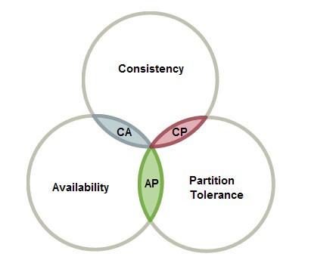
Distributed systems
Sharing of tasks by different computers which may be in different parts of the globe.
Distributed systems made possible what Cloud is today
Advantages
Performance
Reliability
Scalability
Disadvantages
Synchronization
Notes:
3

Slide 4

What is cloud
Simply put, cloud computing is the delivery of computing services—servers, storage,
databases, networking, software, analytics, intelligence and more—over the Internet
Types of Cloud Computing
Public
Private
Hybrid
Types of Cloud Services
Infrastructure as a service (IaaS)
Platform as a service (PaaS)
Serverless computing
Software as a service (SaaS)
Notes:
4

Slide 5

Why cloud
Advantages
Scalability
Costs
Recovery
Competitive edge
Amazon perspective about why using Cloud
Trade capital expense for variable expense
Benefit from massive economies of scale
Stop guessing capacity
Increase speed and agility
Stop spending money on running and maintaining data centers
Go global in minutes
Notes:
5

Slide 6

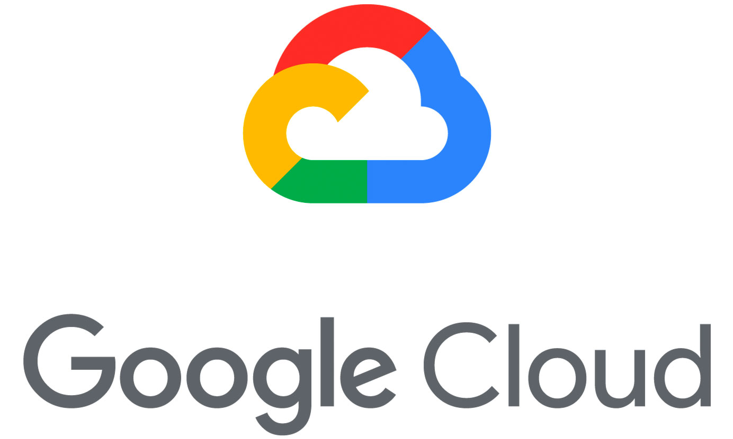




Where is cloud
Notes:
6

Slide 7



What is openshift
What is Openshift
+
=
Notes:
7

Slide 8
Openshift advantages
Notes:
8

Slide 9
Live coding
Notes:
9

Slide 10
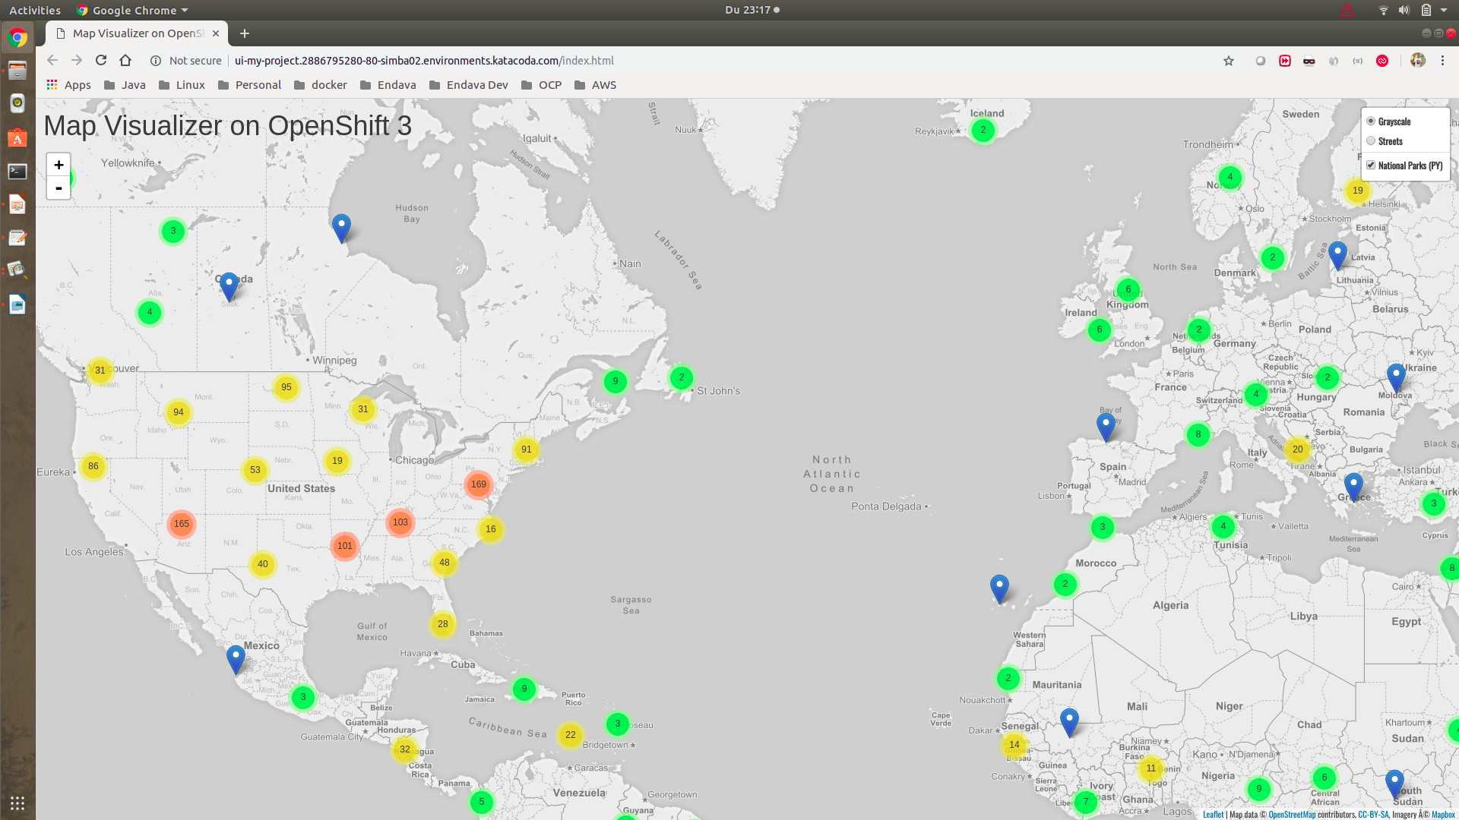
Notes:
10

Slide 11

Serverless computing
Build and run applications without thinking about servers
Why use serverless computing?
Developers can focus on their core product instead of worrying about
managing and operating servers or runtimes
Benefits of serverless computing
no server management
flexible scaling
automated high availability
costs
Notes:
11

Slide 12

Start from vision
A computer on every desk and in every home running Microsoft software
Bill Gates 1980
Every startup, application should start from a vision
Our vision:
Transform any book or article into audio and translate it to other languages
Notes:
12

Slide 13

Amazon polly
Turn text into lifelike speech using deep learning
Benefits
* NATURAL SOUNDING VOICES
* STORE & REDISTRIBUTE SPEECH
* REAL-TIME STREAMING
* CUSTOMIZE & CONTROL SPEECH OUTPUT
* LOW COST
Notes:
13

Slide 14

Amazon S3 storage
Object storage built to store and retrieve any amount of data from anywhere
Benefits
* Unmatched durability, availability and scalability
* comprehensive security and compliance capabilities
* query in place
* flexible management
* most supported by partners, vendors and AWS services
* easy, flexible data transfer
Use cases
* backup and recovery
*data archiving
* data lake and big data analytics
* hybrid cloud storage
* cloud native applications
* disaster recovery
Notes:
14

Slide 15

Dynamo db
Amazon DynamoDB is a nonrelational database that delivers reliable
performance at any scale.
Create a new table for your application and let DynamoDB handle the rest.
Benefits
PERFORMANCE AT SCALE
FULLY MANAGED
ENTERPRISE-READY
Notes:
15

Slide 16

lambda
Run code without thinking about servers. Pay only for the compute time
you consume.
Benefits
NO SERVERS TO MANAGE
CONTINUOUS SCALING
SUBSECOND METERING
Notes:
16

Slide 17

Api gateway
Create, maintain, and secure APIs at any scale
An API that acts as a “front door” for applications to access data,
business logic, or functionality from your back-end servicesand the
amount of data transferred out.
Benefits
LOW COST AND EFFICIENT
PERFORMANCE AT ANY SCALE
EASILY MONITOR API ACTIVITY
STREAMLINE API DEVELOPMENT
FLEXIBLE SECURITY CONTROLS
RUN YOUR APIS WITHOUT SERVERS
CREATE RESTFUL API ENDPOINTS FOR EXISTING SERVICES
Notes:
17

Slide 18

Sns component
Decouple and scale microservices, distributed systems, and serverless
applications
With SNS, you can use topics to decouple message publishers from
subscribers, fan-out messages to multiple recipients at once,
and eliminate polling in your applications.
SNS supports a variety of subscription types, allowing you to push
messages directly to Amazon Simple Queue Service (SQS) queues,
AWS Lambda functions, and HTTP endpoints.
Notes:
18

Slide 19
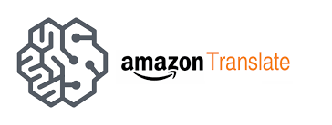
Aws translate
Natural and accurate language translation
neural machine translation service that delivers:
fast,
high-quality,
and affordable language translation
Benefits
Highly Accurate & Continuously Learning
Easy to Integrate into Your Applications
Scalable
Notes:
19

Slide 20
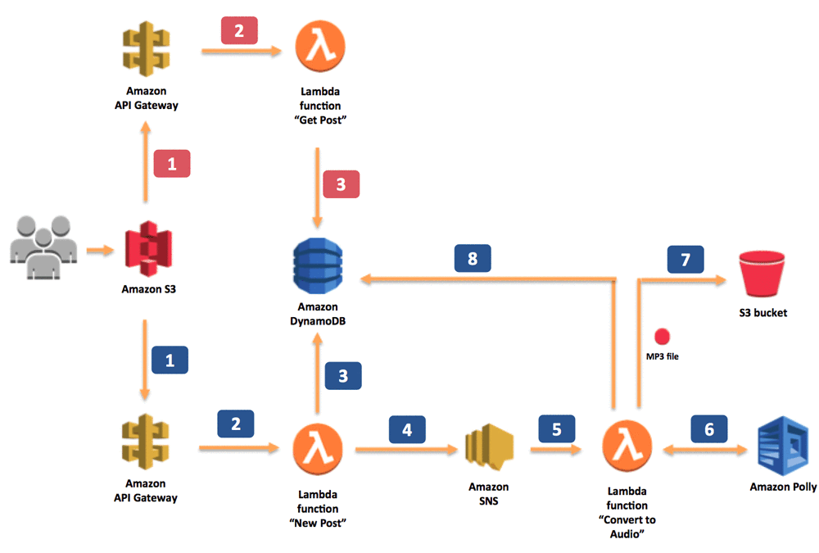
text to speech architecture
Notes:
20

Slide 21
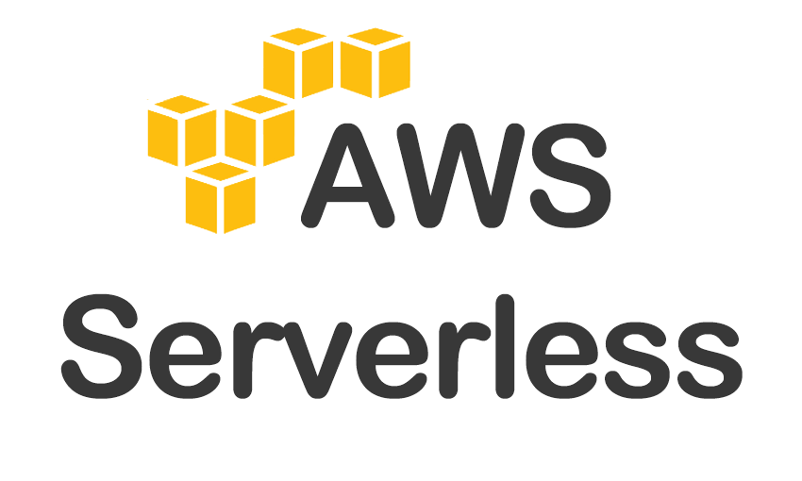
Live coding
Notes:
21

Slide 22
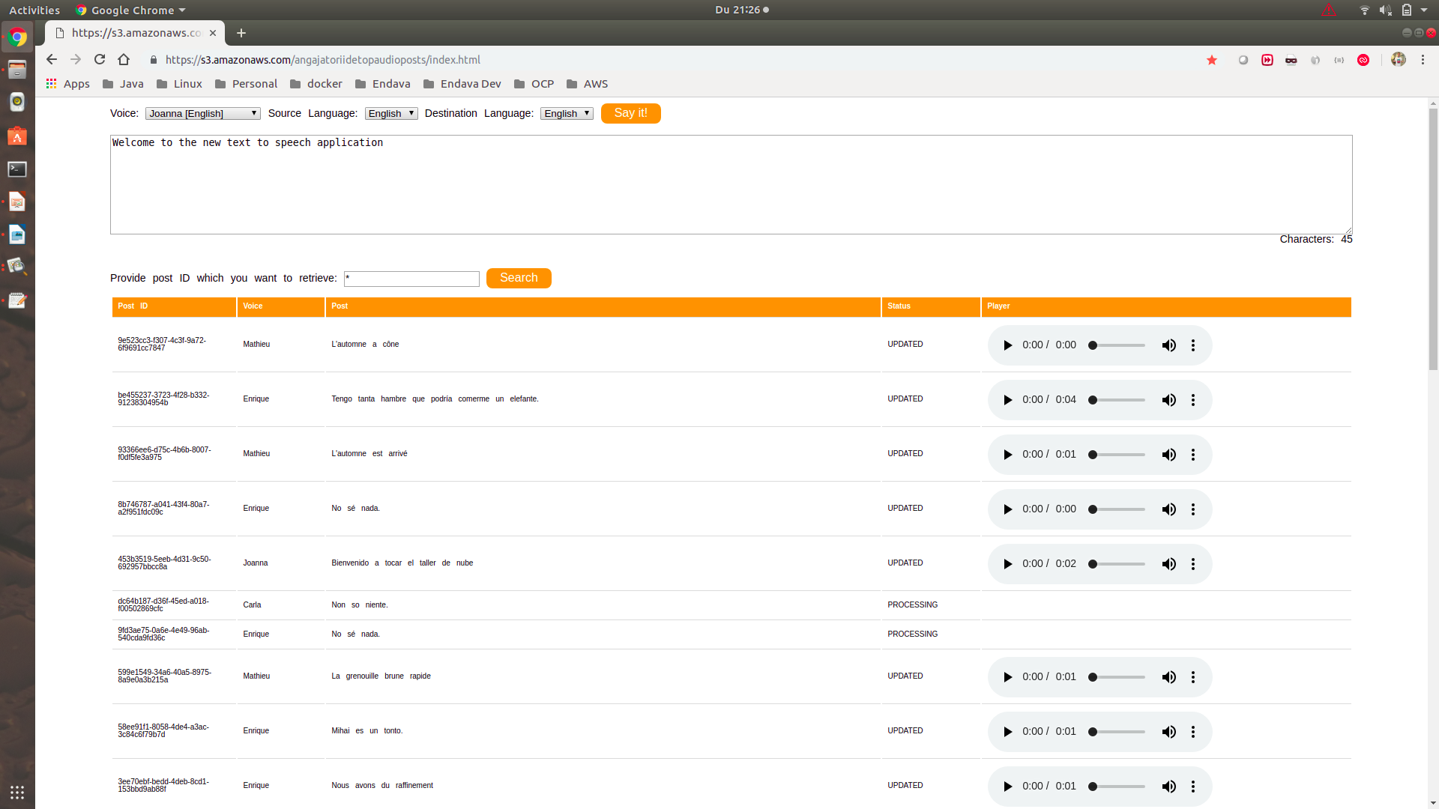
Notes:
22

Slide 23

Next steps
Real time translator
Convert real time audio into another language audio
;
Could be a very good fit to IoT: smart headset, smartphone app,etc
Amazon Transcribe is an automatic speech recognition (ASR) service
that makes it easy for developers to add speech-to-text capability to
their applications.
Key Features
Easy-to-Read Transcriptions
Recognize Multiple Speakers
Channel Identification
Notes:
23

Slide 24
review
Notes:
24

Slide 25

Why you should learn cloud
It is the best option for creating a startup
Perfect suited to test new ideas/solutions
It is already happening better embrace change than resist
Costs – pay per usage
Focus on your business and reuse existing services
Access to services that would be almost impossible to create
Evolve along with the Cloud provider with minimal or no effort
Because probably the cloud providers support your programming language
Notes:
25

Slide 26


Slide 27
THANK YOU
MIHAI STANGACIU
DEVELOPMENT LEAD
Mihai.Stangaciu@endava.com

